Slide 1
CAR POOLING
HOD : G Srinivas Rao
Co-Ordinator : Mehveen M K
Internal Guide : Saleha Farha
Presented by
Ramya Sree Nakka (13321A1269)
Triveni Beravalli(13321A12B6)
Batch no: MP-B-27

Slide 2
Contents
Objective
Existing System
Proposed System and Features
Functional Requirements
System and Technical Architecture
Use Case, Activity, Class, Sequence Diagrams
Database Design - ER Diagram
Module management
Input and output Screen Shots
pseudo code for critical modules/functionality
Test Cases
Conclusion and Future Scope

Slide 3
OBJECTIVE
Our aim is to provide an intranet application which would help the employees within a company to make use of the car pooling facility effectively and organize their car pools more effectively.

Slide 4
EXISTING SYSTEM
Now a days employees moves through private cabs or with their individual vehicles for this every employee has to drive to their respective organization.
Which increases the traffic jam, fuel cost.

Slide 5
Proposed System
There is the system for the admin who can enter employee details like name, gender etc.
Each and every employee can register on the website providing his name, contact number and employee id. Once the registration is done, then based on your route, and shift timings, the website will provide you the list of members who can be on your car pool
One route can have many car pools.

Slide 6
Functional Requirements
EMPLOYEE
This system allows employee to register in order to access our application to make use of car pool
Registered employee can login to Create or join of car pool
Application provides different car pools available in different places .
ADMIN
New car pools can be accepted or rejected
Simultaneously adds the employees of the Organization and can update other details.

Slide 7
SYSTEM ARCHITECTURE:
ARCHITECTURE
Car pooling
Application
Admin
Employee
Login
Add employee
View employees
Delete employees
Accept/Reject carpool
Registration
Login
Database
Create carpool
Searches for carpool
Joins the carpool
Deletes from Carpool
Logout
Logout

Slide 8
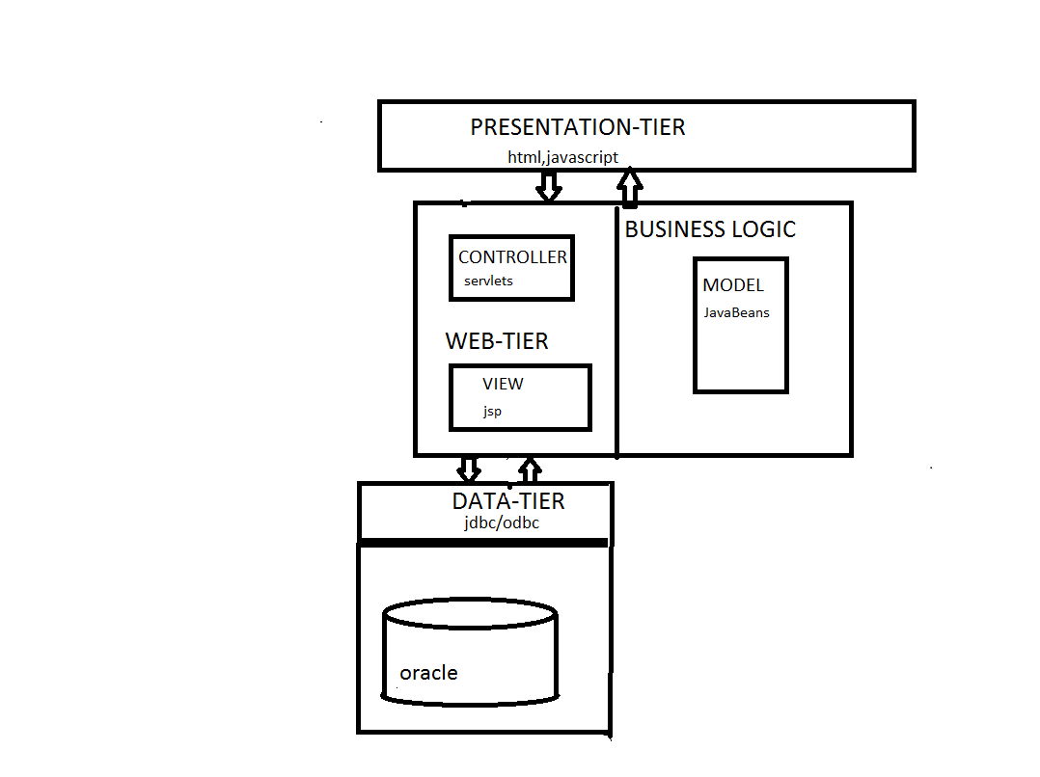
Architecture
TECHNICAL ARCHICTURE

Slide 9
USE CASE DIAGRAM
Admin :

Slide 10
USE CASE DIAGRAM
Employee :

Slide 11
SEQUENCE DIAGRAM
Employee Registration :

Slide 12
SEQUENCE DIAGRAM
Employee Login:

Slide 13
SEQUENCE DIAGRAM
Employee Create Carpool:

Slide 14
SEQUENCE DIAGRAM
Employee Search,Join Carpool:

Slide 15
SEQUENCE DIAGRAM
Admin Login:

Slide 16
SEQUENCE DIAGRAM
Admin Add /Update:

Slide 17
CLASS DIAGRAM

Slide 18
ACTIVITY DIAGRAM
Employee

Slide 19
ACTIVITY DIAGRAM
ADMIN:

Slide 20
Er Diagram

Slide 21
MODULES
EMPLOYEE: The employee can log in and search for the required pool he wants and sends a request to that particular pool
ADMIN: The admin can log in into the system and can update the database if there are any changes regarding the timings of the pool, change in the route, etc and the admin has the right to maintain the data base.

Slide 22
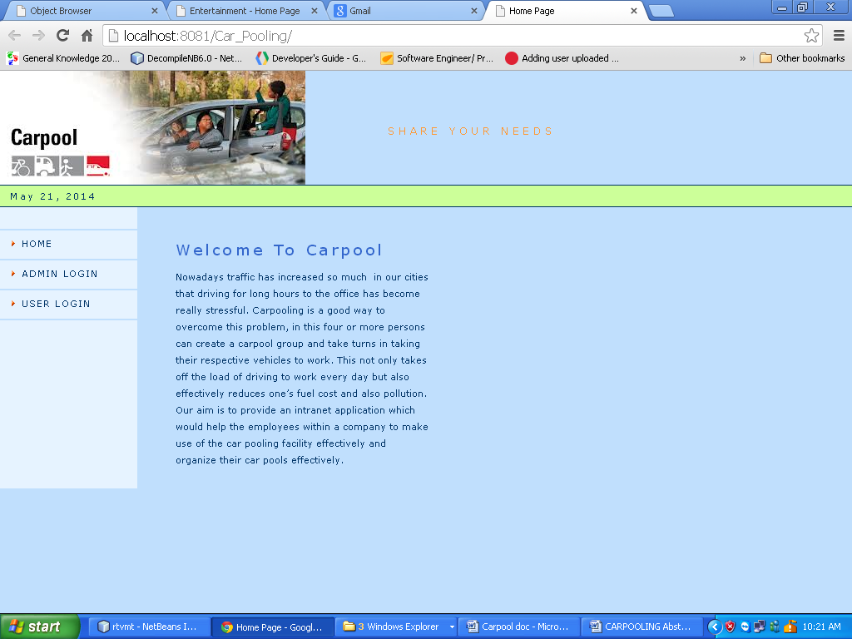
Carpool Home page:

Slide 23
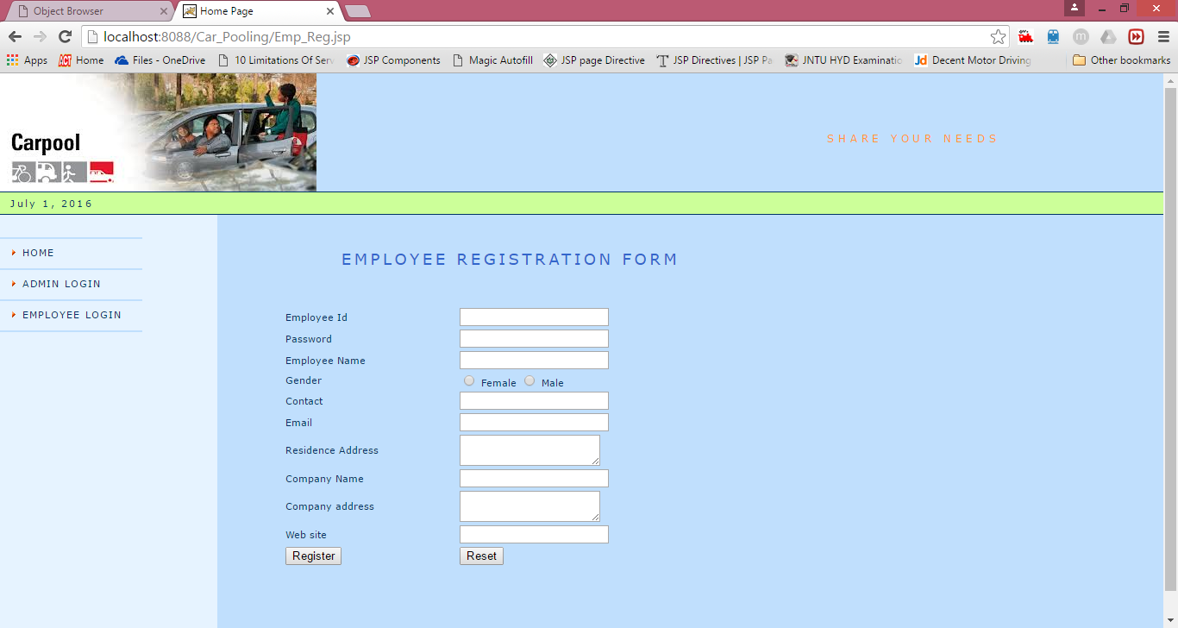
Employee Registration :

Slide 24
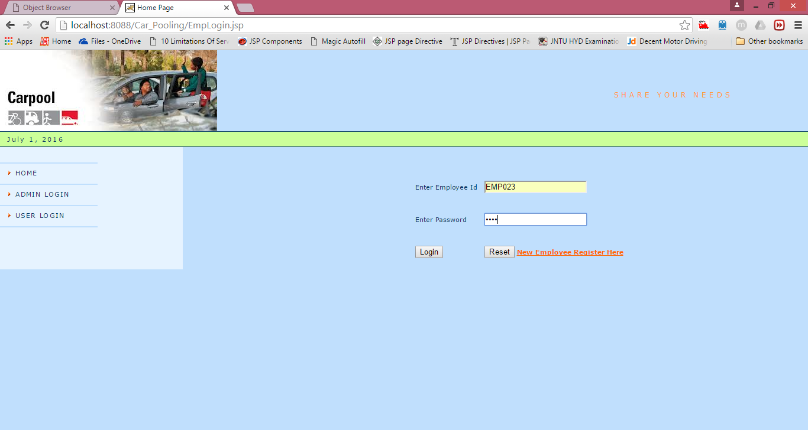
Employee Login:

Slide 25
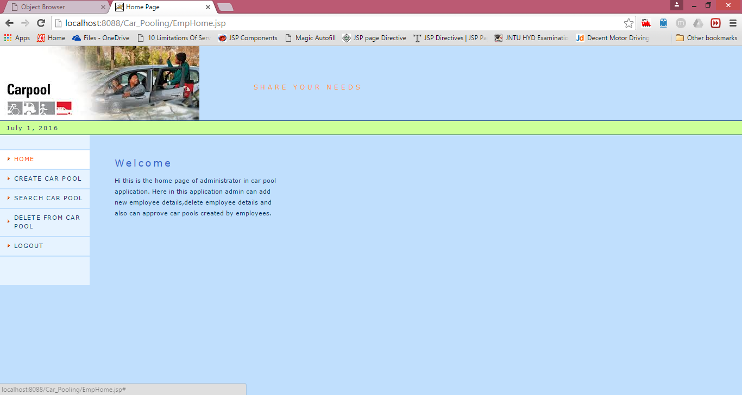
Screenshots
Employee Login Home Page:

Slide 26
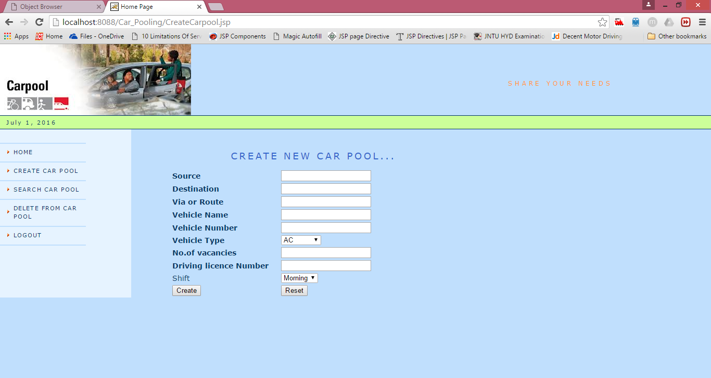
Employee Create Carpool:

Slide 27
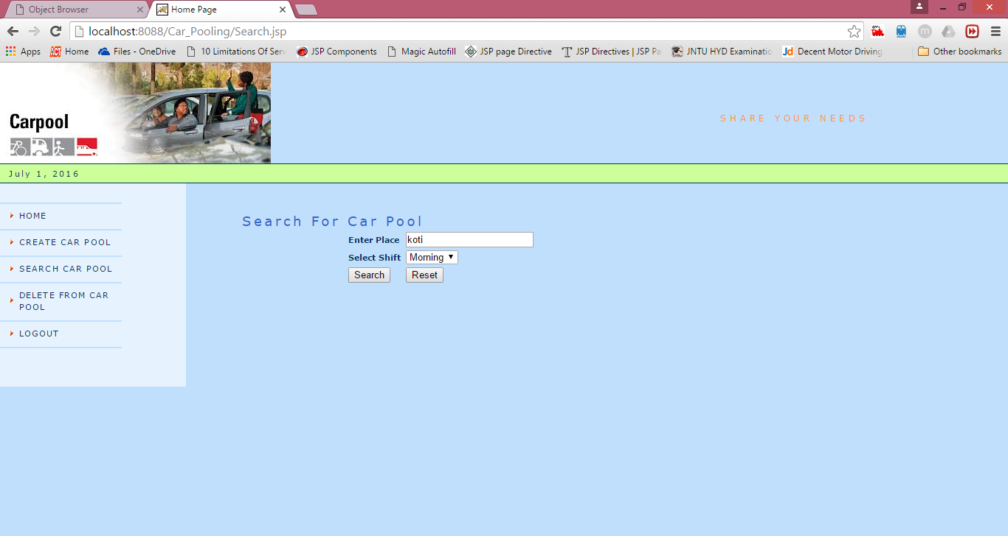
Employee Search carpool:

Slide 28
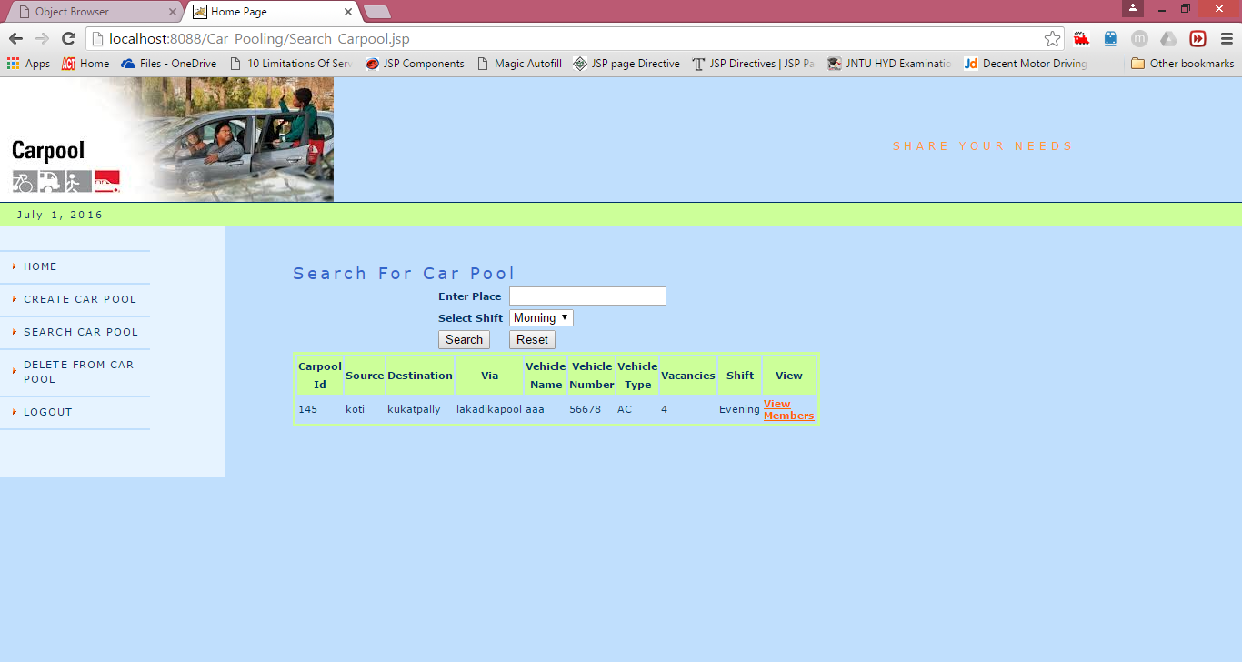
Search:

Slide 29
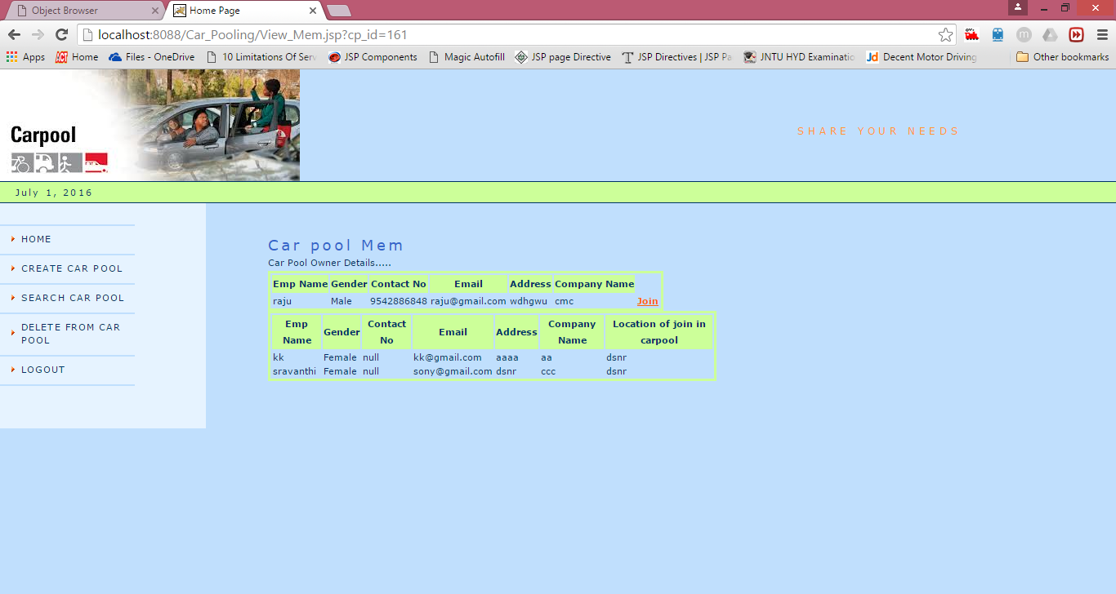
Employee Joins Carpool

Slide 30
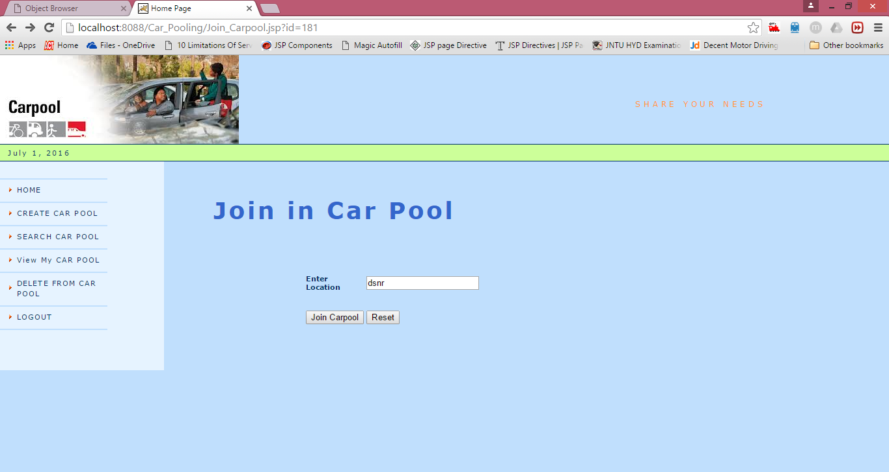

Slide 31

Employee Joins Succesfully:

Slide 32
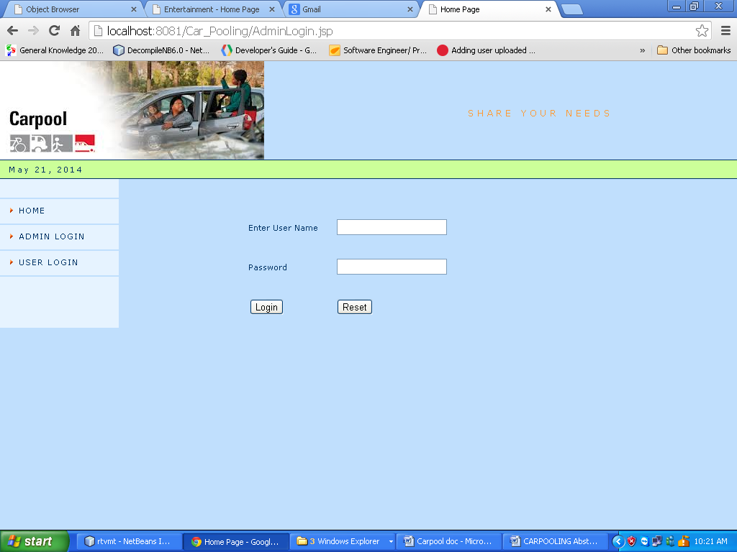
Carpool Admin Login Page

Slide 33

Carpool Admin Homepage

Slide 34
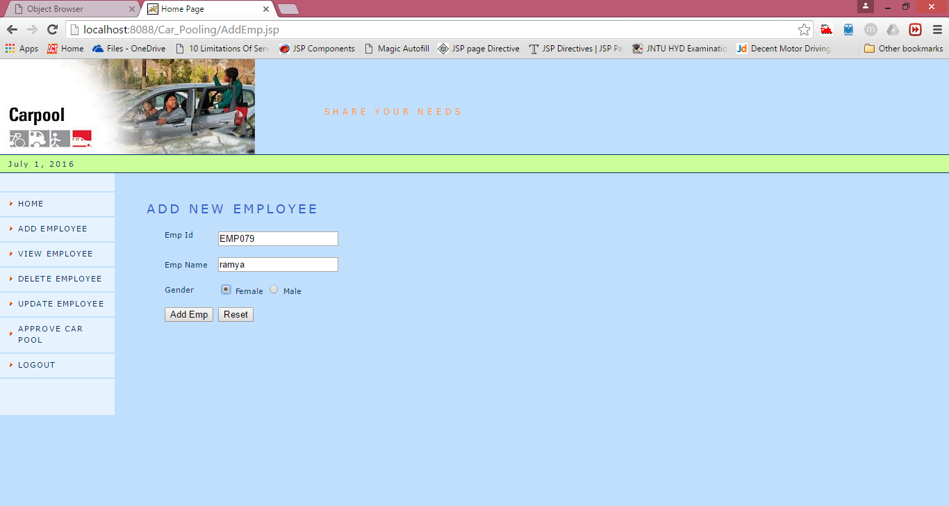
Carpool Add Employee page

Slide 35
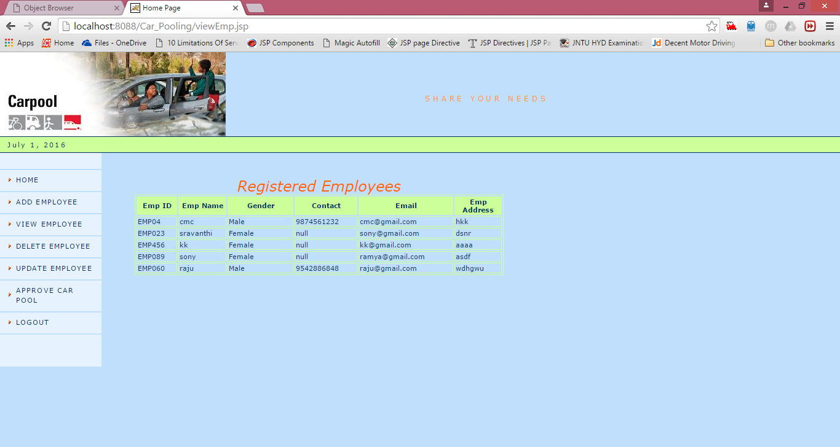
Admin Views Employee Details

Slide 36
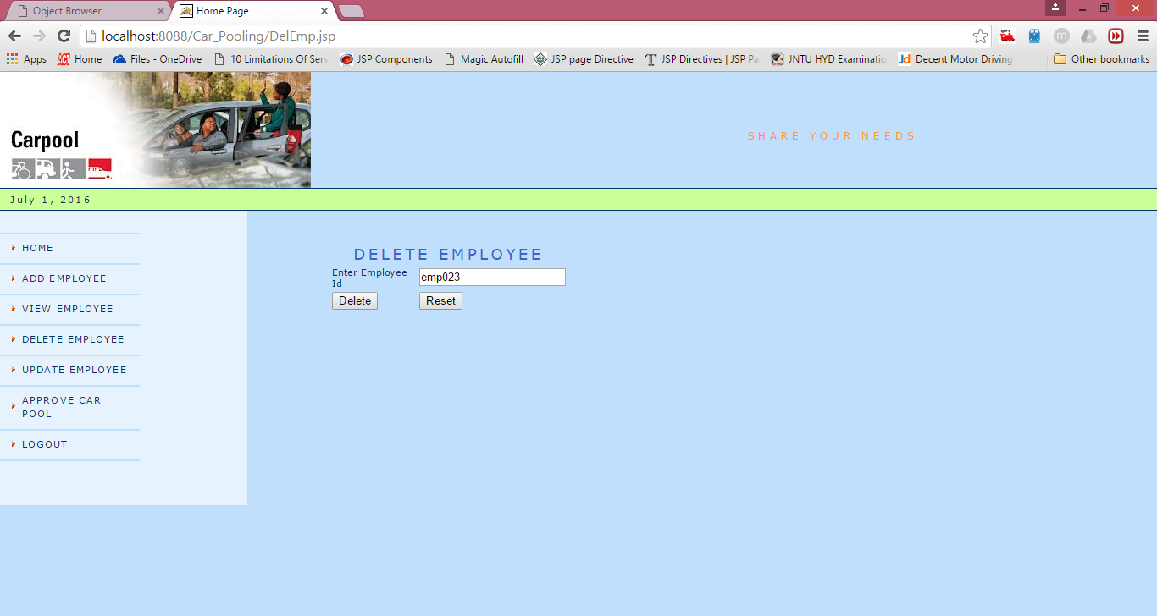
Carpool Delete Employee Page

Slide 37
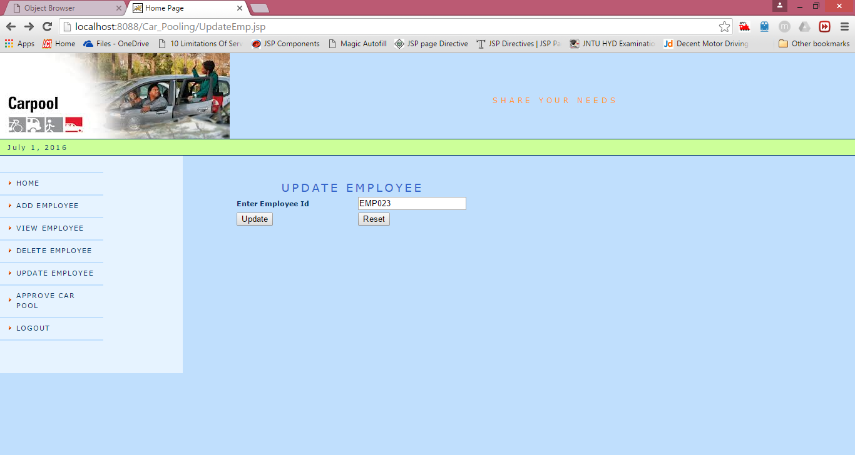
Update Employee

Slide 38
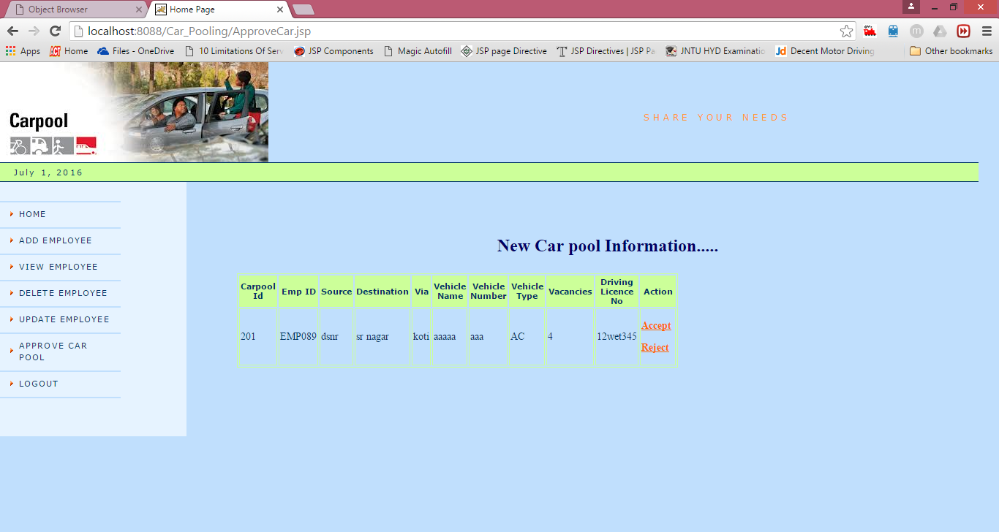
Accept/Reject Carpool:

Slide 39
Source Code
Front End page
<body bgcolor="#C0DFFD">
<td height="64" colspan="3" align="center" valign="top" bgcolor="#C0DFFD" id="tagline">SHARE YOUR NEEDS </td>
</tr> <tr>
<td colspan="7" bgcolor="#003366"><img src="mm_spacer.gif" alt="" width="1" height="1" border="0" /></td> </tr>
<tr bgcolor="#CCFF99">
<td colspan="7" id="dateformat“
height="25">&nbsp;&nbsp;<script language="JavaScript" type="text/javascript“
document.write(TODAY);</script></td></tr>
<tr>
<td colspan="7" bgcolor="#003366"><img src="mm_spacer.gif" alt="" width="1" height="1" border="0" /></td>
</tr>
<tr>
<td width="165"><a href="EmpHome.jsp" class="navText">HOME</a></td>
</tr>
<tr>
<td width="165"><a href="CreateCarpool.jsp" class="navText">CREATE CAR POOL </a></td>
</tr>
<tr>
<td width="165"><a href="Search.jsp" class="navText">SEARCH CAR POOL </a></td>
</tr>
<tr>
<html xmlns="http://www.w3.org/1999/xhtml">
<head>
<title>Home Page</title>
<meta http-equiv="Content-Type" content="text/html;
charset=iso-8859-1" />
<link rel="stylesheet" href="mm_travel2.css“
type="text/css" />
<script language="JavaScript" type="text/javascript">
//--------------- LOCALIZEABLE GLOBALS ---------------
var d=new Date();
var monthname=new Array("January","February","March","April","May","June","July","August","September","October","November","December");
//Ensure correct for language. English is "January 1, 2004"
var TODAY = monthname[d.getMonth()] + " " + d.getDate() + ", " + d.getFullYear();
//--------------- END LOCALIZEABLE ---------------
</script>
<script language="JavaScript" src="gen_validatorv31.js" type="text/javascript"></script>
<style type="text/css">
<!--
.style6 {
font-size: 14px;
font-weight: bold;
}
.style8 {font-size: 14px}
-->
</style>
</head>

Slide 40
Source Code
<td width="165"><a href="DeleteFrom.jsp" class="navText">DELETE FROM CAR POOL </a></td>
</tr>
<tr>
<td width="165"><a href="Logout.jsp" class="navText">LOGOUT</a></td>
</tr>
</table>
<table border="0" cellspacing="0" cellpadding="0" width="548">
<tr>
<%
String message=request.getParameter("msg");
if(message!=null && message.equalsIgnoreCase("created"))
out.println("<font color='Green'>Car Pool created sucssesfully</font>");
%>
<td class="pageName"><div align="center">CREATE NEW CAR POOL... </div></td>
</tr>
</table>
<br />
<form id="form1" name="form1" method="post" action="Create_Carpool.jsp">
<table width="536" height="197">
<tr>
<td width="205"><span class="style6">Source</span></td>
<td width="319"><label>
<input name="source" type="text" id="source" />
</label></td>
</tr>
<tr>
<td><span class="style6">Destination</span></td>
<td><label>
<input name="destination" type="text" id="destination" />
</label></td>
</tr>
<tr>
<td><span class="style6">Via or Route </span></td>
<td><label>
<input name="via" type="text" id="via" />
</label></td>
</tr>
<tr>
<td><span class="style6">Vehicle Name </span></td>
<td><label>
<input name="vname" type="text" id="vname" />
</label></td>
</tr>
<tr>
<td><span class="style6">Vehicle Number </span></td>
<td><label>
<input name="vno" type="text" id="vno" />
</label></td>
</tr>
<tr>
<td height="15"><span class="style6">Vehicle Type </span></td>
<td><label>
<select name="vtype">
<option>AC</option>
<option>NON AC</option>
</select>
</label></td>
</tr>

Slide 41
Source Code
<td><span class="style6">No.of vacancies </span></td>
<td><label>
<input name="vacancies" type="text" id="vacancies" />
</label></td>
</tr>
<tr>
<td><span class="style6">Driving licence Number </span></td>
<td><label>
<input name="lno" type="text" id="lno" />
</label></td>
</tr>
<tr>
<td><span class="style8">Shift</span></td>
<td><select name="shift">
<option>Morning</option>
<option>Evening</option>
<option>Night</option>
</select></td>
</tr>
<tr>
<td><span class="style8">
<label>
<input type="submit" name="Submit" value="Create" />
</label>
</span></td>
<td><label>
<input type="reset" name="Submit2" value="Reset" />
</label></td>
</tr>
</table>
</form>
<script language="JavaScript" type="text/javascript">
var frmvalidator = new Validator("form1");
frmvalidator.addValidation("source","req","Please enter source");
frmvalidator.addValidation("destination","req","Please destination");
frmvalidator.addValidation("via","req","Please enter Via");
frmvalidator.addValidation("vname","req","Please enter vehicle name");
frmvalidator.addValidation("vacancies","numeric");
frmvalidator.addValidation("vacancies","req","Please enter no of vacancies");
frmvalidator.addValidation("lno","req","Please enter Licence no");
</script>
</td> </tr>
<tr>
<td width="165">&nbsp;</td>
<td width="50">&nbsp;</td>
<td width="167">&nbsp;</td>
<td width="138">&nbsp;</td>
</tr>
</table>
</body>
</html>

Slide 42
Source code
Stores the details
Create_Carpool.jsp:
<jsp:useBean id="dbcon" class="databasecon.DataBase"/>
<%@page import="java.sql.*" %>
<%!
Connection con;
PreparedStatement pst;
ResultSet rs;
int id;
String eid,source,destination,via,vname,vno,vtype,vacancies,lno,shift;
%>
<%
con=dbcon.getCon();
eid=session.getAttribute("eid").toString();
source=request.getParameter("source");
destination=request.getParameter("destination");
via=request.getParameter("via");
vname=request.getParameter("vname");
vno=request.getParameter("vno");
vtype=request.getParameter("vtype");
vacancies=request.getParameter("vacancies");
lno=request.getParameter("lno");
shift=request.getParameter("shift");
pst=con.prepareStatement("insert into carpool values(1,?,?,?,?,?,?,?,?,?,'No',?) ");
pst.setString(1, eid);
pst.setString(2, source);
pst.setString(3, destination);
pst.setString(4, via);
pst.setString(5, vname);
pst.setString(6, vno);
pst.setString(7, vtype);
pst.setString(8, vacancies);
pst.setString(9, lno);
pst.setString(10, shift);
int i=pst.executeUpdate();
if(i>0)
response.sendRedirect("CreateCarpool.jsp?msg=created");
con.close();
// out.print("car pool created.....");

Slide 43
TEST CASES
Employees Login:
TEST CASE | INPUT | EXPECTED BEHAVIOUR | OBSERVED BEHAVIOUR | STATUS PASS FAIL
1. | Enter the incorrect login id ,password | Displays message “ invalid user name and password” | -do- | Pass
2. | Enter blank values | Displays an alert message “enter valid value for corresponding field” | -do- | Pass
3. | Enter the correct login id and password | Displays authorized action to user | -do- | Pass

Slide 44
TEST CASES
Employee Registration:
TEST CASE | INPUT | EXPECTED BEHAVIOUR | OBSERVED BEHAVIOUR | STATUS PASS FAIL
1. | Enter the incorrect field values | Displays an alert message “ invalid user name and password” | -do- | pass
2. | Enter blank values | Displays an alert message “enter valid value for corresponding field” | -do- | pass

Slide 45
TEST CASES
Admin Login:
TEST CASE | INPUT | EXPECTED BEHAVIOUR | OBSERVED BEHAVIOUR | STATUS PASS FAIL
1. | Enter the incorrect login id ,password | Displays message “ invalid user name and password” | -do- | pass
2. | Enter blank values | Displays an alert message “enter valid value for corresponding field” | -do- | Pass
3. | Enter the correct login id and password | Displays authorized action to user | -do- | Pass

Slide 46
Conclusion
By this Application we can reduce the Following
Cost Effective
Inexpensive travelling
Reduce Traffic jam
Reduce Air Pollution

Slide 47
FUTURE SCOPE
In Future we can incoporate the Following Functions:
Can Provide the Message Alerts
Can Provide Password Encryption

Slide 48


